Slide 1
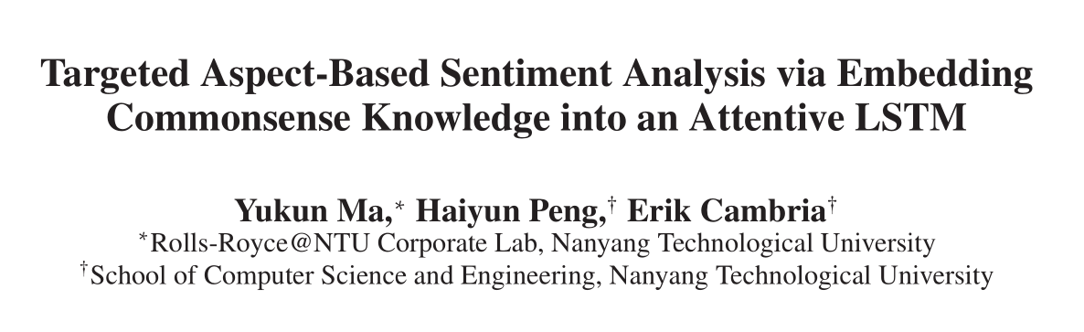
AAAI2018

Slide 2
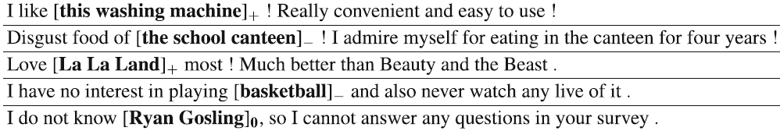
相关概念
Targeted sentiment analysis studies the sentiment polarity toward a certain entity in one sentence.

Slide 3
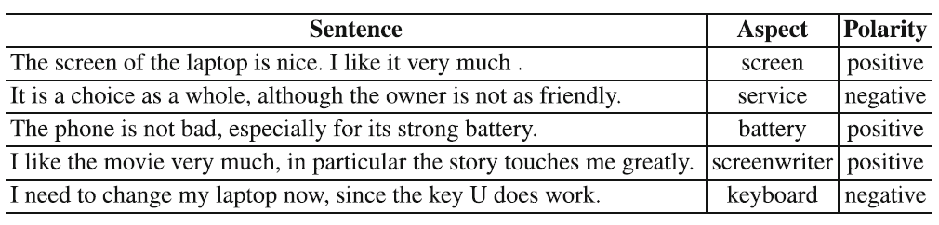
相关概念
Aspect-level sentiment analysis aims to classify the sentiment polarities in a sentence for an aspect. An aspect is one attribute of a target, over which human can express their opinions.

Slide 4
解决的问题
Targeted Aspect-Based Sentiment Analysis：
A sentence s consists of a sequence of words, we consider all mentions of the same target as a single target. A target t denoted as T = {t1,t2,⋯,ti,⋯,tm},the task of targeted ABSA can be divided into two subtasks.
Firstly, it resolves the aspect categories of t belonging to a predefined set.Secondly,it classifies the sentiment polarity with respect to each aspect category associated with t.
“I live in [West London] for years. I like it and it is safe to live in much of [West London].”
The desired output for [WestLondon] is [‘general’:positive;
‘safety’:positive]

Slide 5
以前工作的问题
1.当一个target含有多个单词时，现有的模型假设所有单词对最后aspect情感计算的重要性是一致的，并简单地在这些单词中计算出一个平均向量。
2.现有模型用的注意力机制建立的单词和给定target和aspect的联系很模糊，不能很好地关联它们之间的关系。
3.没有很好地引入外部知识如常识。

Slide 6
创新点
1.创建了多层attention模型来分别明确计算目标词（target）和整个句子。
2.引入外部知识，扩展LSTM单元。
3.将常识性情感知识融入深层神经网络。

Slide 7
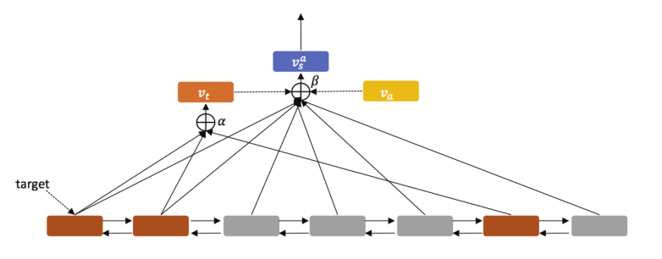
模型框架：

Slide 8







Target-Level Attention

Slide 9





Sentence-Level Attention
Given a sentence s of length L

Slide 10
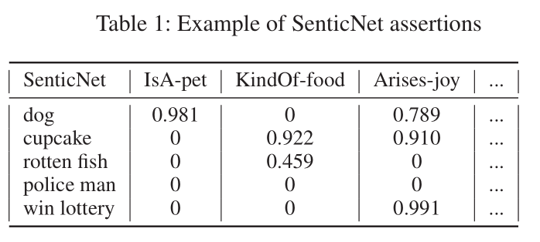
Commonsense Knowledge
we use commonsense knowledge as our knowledge source to be embedded into the sequence encoder. In particular, we use SenticNet (Cambria et al. 2016), a commonsense knowledge base that contains 50,000 concepts associated with a rich set of affective properties.

Slide 11
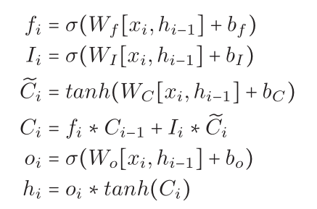
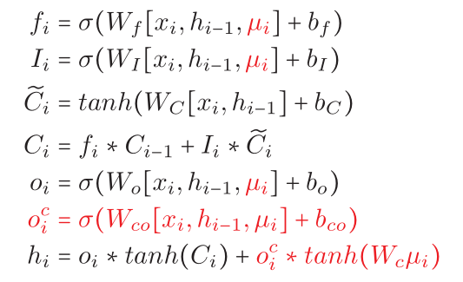


Sentic LSTM
LSTM
Sentic LSTM

Slide 12
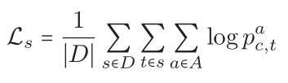

Prediction

Slide 13
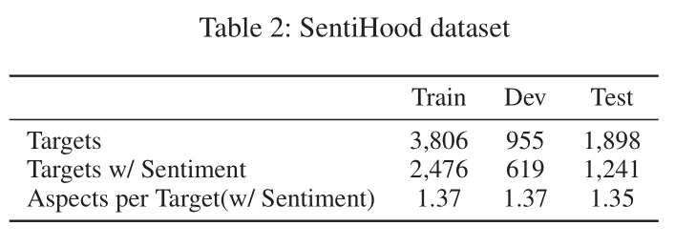
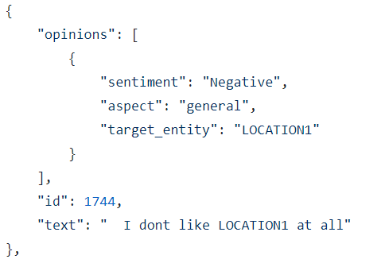
实验数据集
两个数据集：
1.SentiHood
2.Semeval 2015

Slide 14
实验评价指标
aspect categorization：treat the outputs of aspect-based classification as hierarchical classes. we output the label (e.g., in the 3-class setting, it outputs ‘Positive’,’Negative’,or‘None’) with the highest probability for each aspect.
aspect-based sentiment classification：we ignore the scores of ‘None’. For evaluating the aspect-based sentiment classification, we simply calculate the accuracy averaged over aspects.

Slide 15
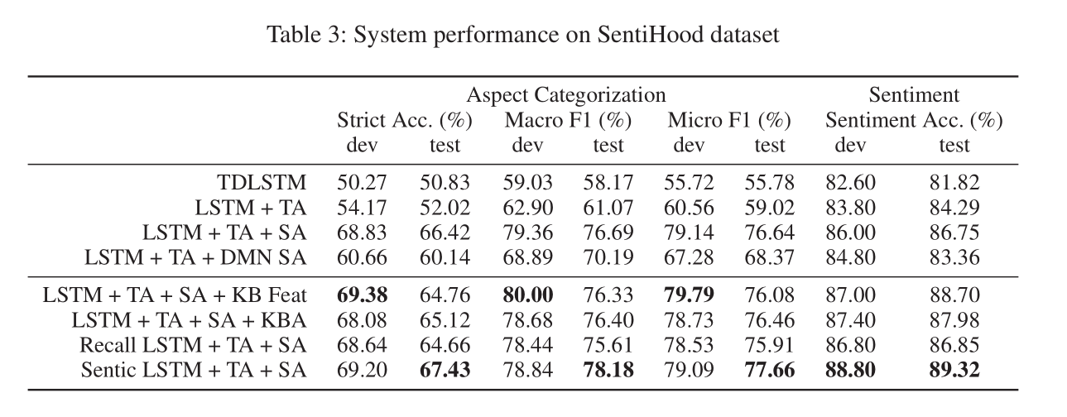
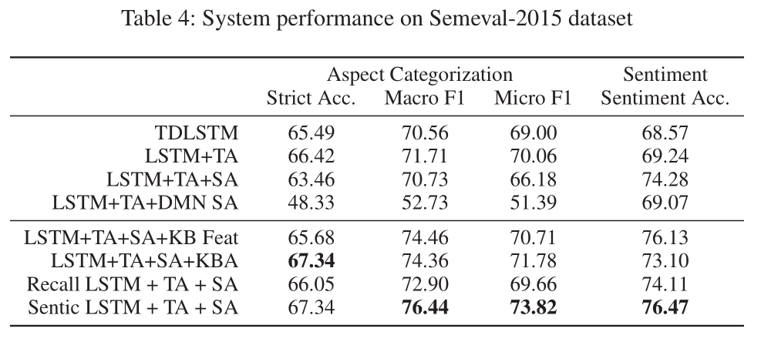
实验结果

Slide 16
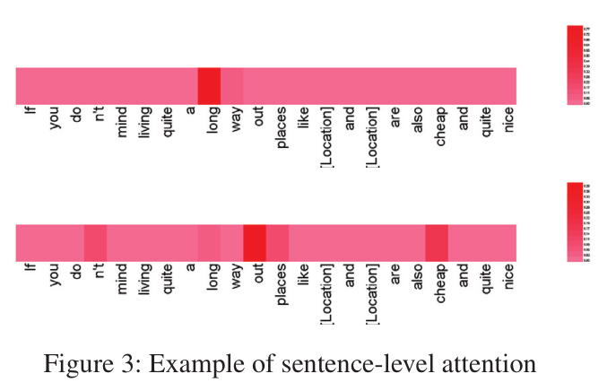
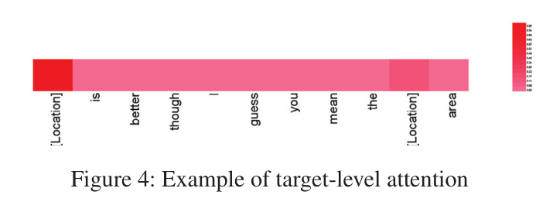
Attention可视化

Slide 17
结论
本文创建了多层attention模型来分别编码目标词（target）和整个句子，同时论文也提出了扩展后的LSTM模型来引入外部常识。

Slide 18
谢谢！

